Slide 1
Document and Re-implement
LZMA Algorithm
Shaoqin Lin, Tianhao Zhao

Slide 2
Routine
Introduction of LZMA
Steps of LZMA Algorithm
Delta coding
Sliding dictionary window
Ranged coding
Project demo
Comparison with other algorithms

Slide 3
Introduction
LZMA: Lemple-Ziv-Markov Chain Algorithm
Lemple-Ziv(LZ77) + Markov Chain

Slide 4
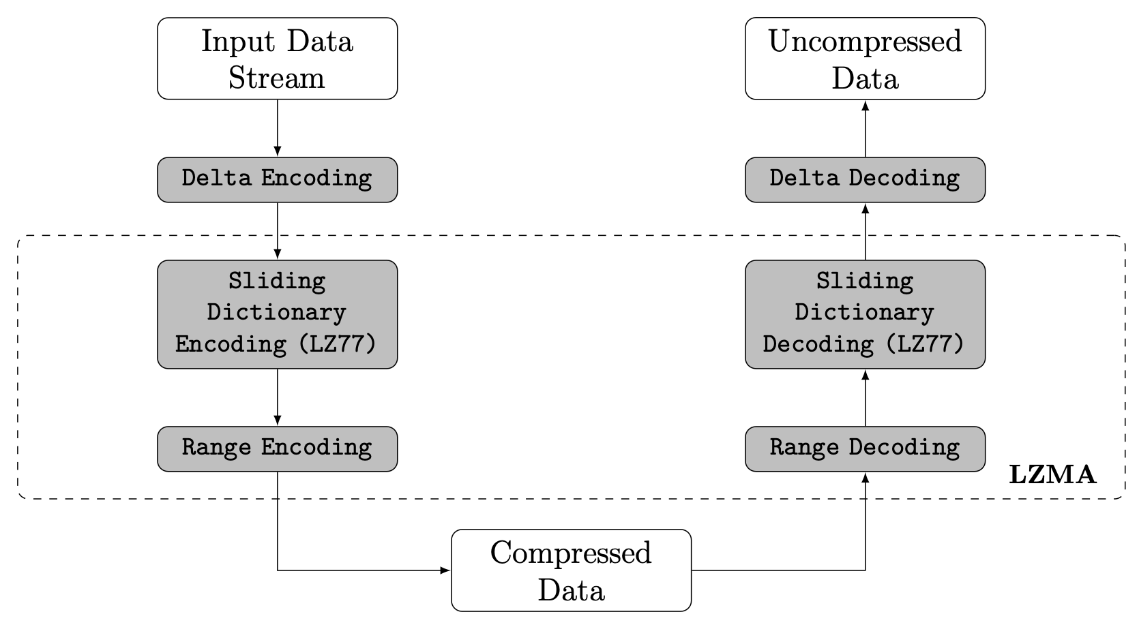
Introduction
LZMA compression and decompression block diagram
(Augusto Y.Horita & Ricardo B., 2019)

Slide 5
2.1 Delta coding
Purpose: effective compression by next step
Example (Adapted from E.Jebamalar)
Input sequence | 2 | 3 | 4 | 6 | 7 | 9 | 8 | 7 | 5
Encoded output | 2 | 1 | 1 | 2 | 1 | 2 | -1 | -1 | -2
Symbols in input | 8 (from 2 ~ 9)
Symbols in output | 4 (-2,-1,1,2)
Notes:
Hardware Implementation of LZMA Data Compression Algorithm(E. Jebamalar Leavline & D.Asir, 2013)

Slide 6
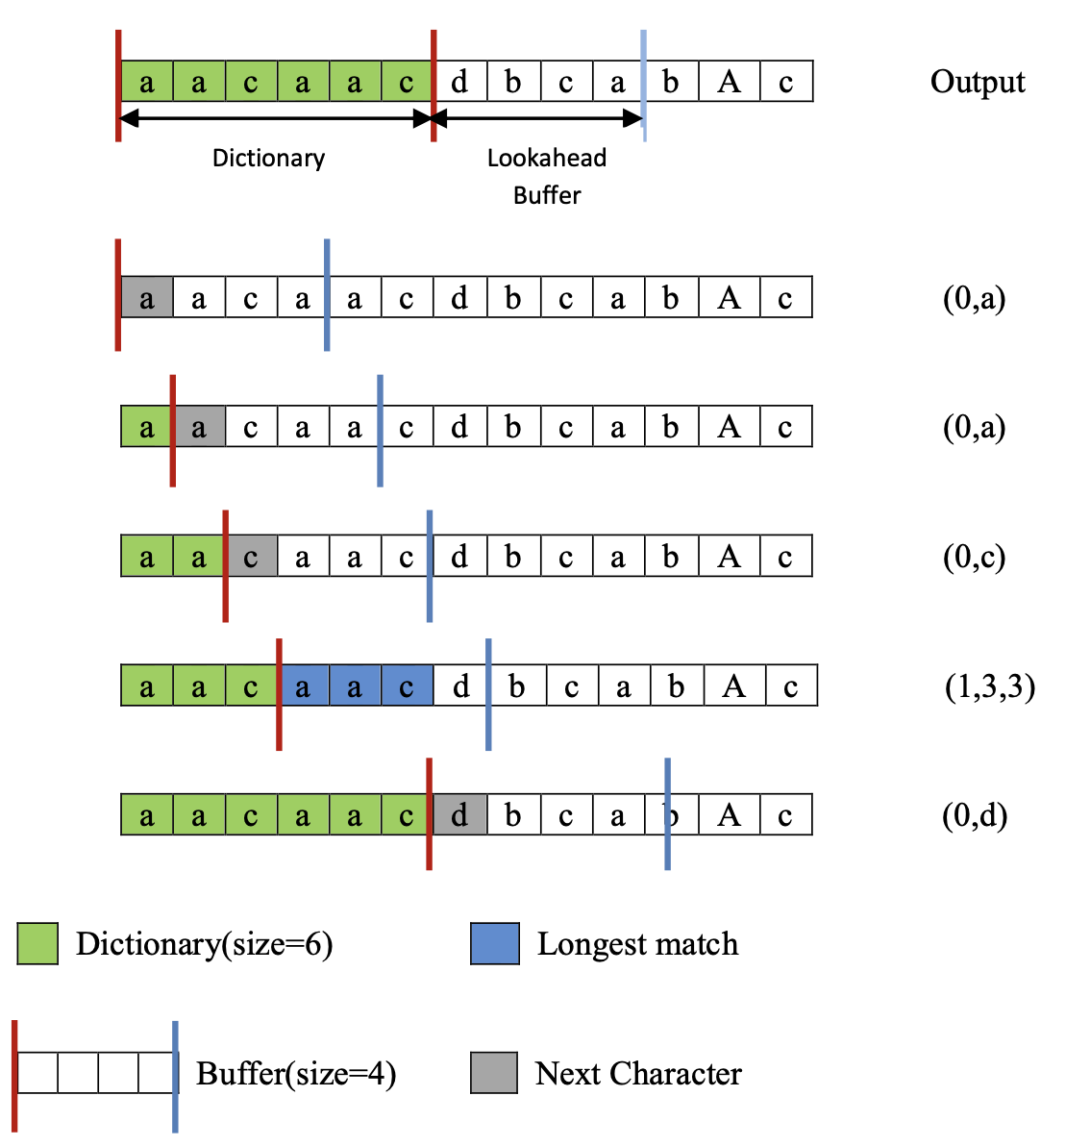
2.2 Sliding dictionary window
Example of sliding dictionary compression (LZ77)
(Jing Zhang, 2015)
Notes:
Real-Time Lossless Compression of SoC Trace Data(Jing Zhang, 2015)

Slide 7
2.2 Sliding dictionary window
Optimized search algorithms: in order to perform faster searches in dictionary, such as hashed chain, binary tree
Example
Node | String
11 | abm
24 | abcd2
30 | abcx
57 | abcd1
78 | aby
Notes:
Handbook of Data Compression(5th edition), p414~415

Slide 8
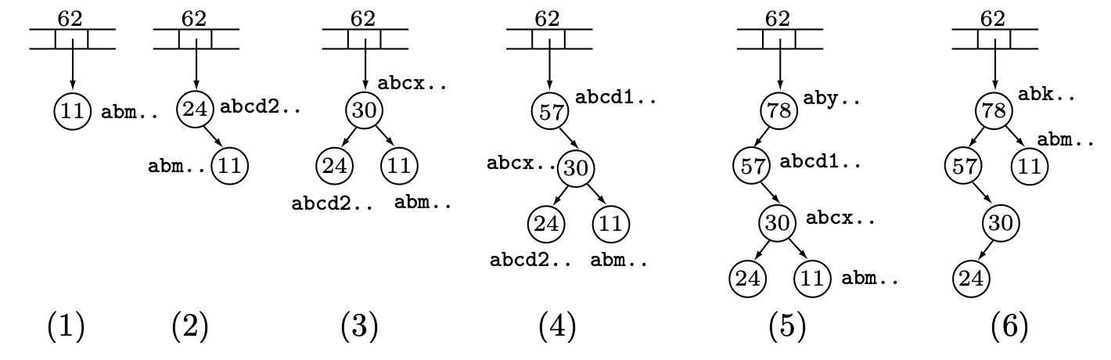
2.2 Sliding dictionary window
Node | 11 | 24 | 40 | 57 | 78
String | abm | abcd2 | abcx | abcd1 | aby
Binary Search Trees in LZMA (David, 2010)

Slide 9
2.3 Ranged Coding
Mathematic support: Markov chain (Focus on probability)
Given a wide range of integers, and probability estimation for the symbols.
Divide the range into proper sub-ranges
Encode by reducing the current range down that sub-range which corresponds to the next symbol to the encoded

Slide 10
2.3 Ranged Coding
Range Encoder:
(xz) variables: low, range, cache, cache-size, nice_len
Range Decoder:
range, code, prob
Context-based with probability variable prob
set bound

Slide 11
3. Project Demo

Slide 12


Slide 13
4. Comparison
Algorithms | Advantage | Disadvantage
Prior to LZMA | Byte-based Use a cascade of context to represent dependencies on previous bits from a byte | LZMA has much larger dictionary sizes than classic dictionary compression (one used in zip/gzip formats
LZMA | Context-based Represent literal or phrase instead of byte Avoid mixing unrelated bits together

Slide 14
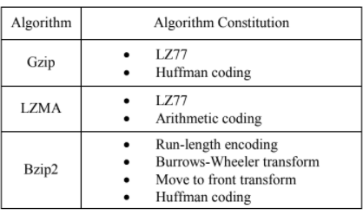
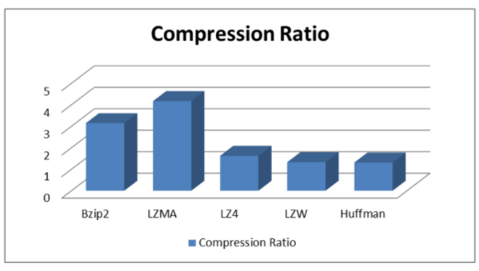
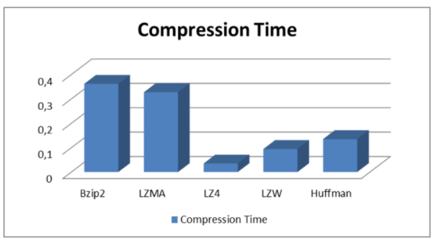
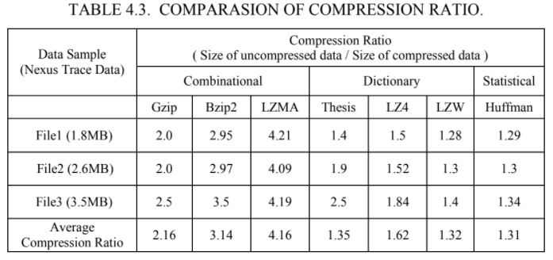
Notes:
Zhang, Jing. Real-Time Lossless Compression of SoC Trace Data. Dec. 2015, www.eit.lth.se/sprapport.php?uid=900.

Slide 15
Thank you!

Slide 16
References
Alakuijala, Jyrki, and Evgenii Kliuchnikov. Comparison of Brotli, Deflate, Zopfli, LZMA, LZHAM and ... Google, Inc., cran.r-project.org/web/packages/brotli/vignettes/brotli-2015-09-22.pdf.
Bin Tariq, Zaid, et al. “Enhanced LZMA and BZIP2 for Improved Energy Data Compression.” Proceedings of the 4th International Conference on Smart Cities and Green ICT Systems, 2015, doi:10.5220/0005454202560263.
Handbook of Data Compression, by David Salomon and Giovanni Motta, Springer London, 2010, pp. 414–423.
Horita, Augusto Y., et al. “Lempel-Ziv-Markov Chain Algorithm Modeling Using Models of Computation and ForSyDe.” Proceedings of the 10th Aerospace Technology Congress, October 8-9, 2019, Stockholm, Sweden, 2019, doi:10.3384/ecp19162017.
Lan, Cuiling, et al. “Compound Image Compression Using Lossless and Lossy LZMA in HEVC.” 2015 IEEE International Conference on Multimedia and Expo (ICME), 2015, doi:10.1109/icme.2015.7177430.
Leavline, E.Jebamalar, and D.Asir Antony Gnana Singh. Hardware Implementation of LZMA Data Compression Algorithm. 4 Nov. 2013, research.ijais.org/volume5/number4/ijais12-450900.pdf.
Zhang, Jing. Real-Time Lossless Compression of SoC Trace Data. Dec. 2015, www.eit.lth.se/sprapport.php?uid=900.
Notes:
MLA8 format

